Slide 1
INTERN PERFORMANCE ANALYTICS DASHBOARD
SPRINT 3
Nagamani A [RXS26155]

Slide 2
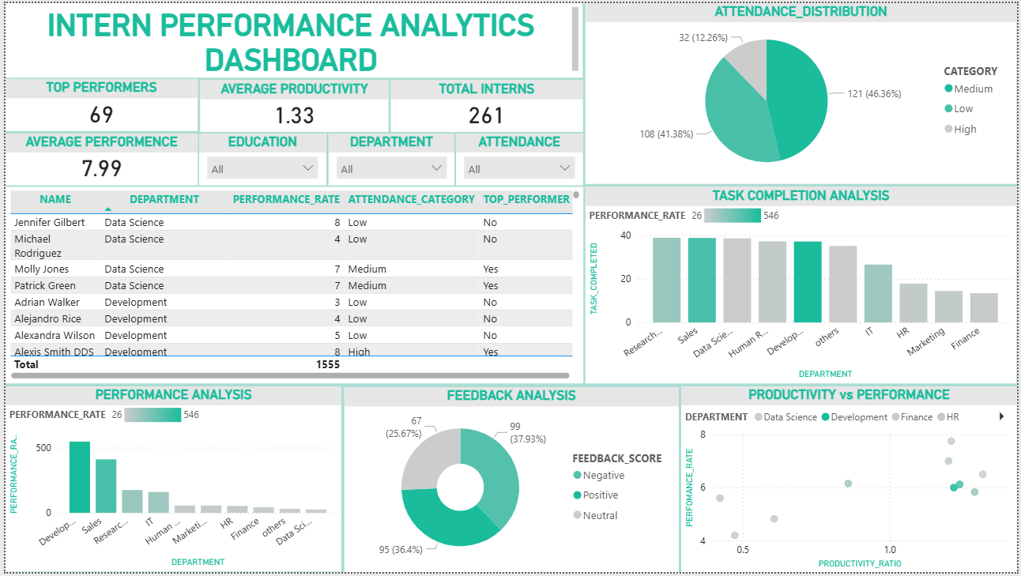

Slide 3
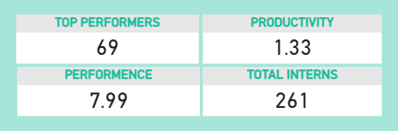
CARD VALUES
Total Interns
Average Performance
Top Performers
Average Productivity

Slide 4
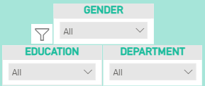
FILTERS
Department Filter
Gender Filter
Education Filter

Slide 5
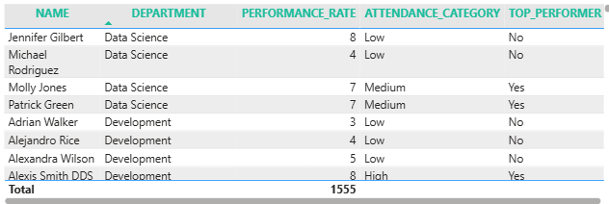
TABLE
Displays intern-level information
Includes key attributes:
Name
Department
Performance
Attendance
Top Performer
Supports detailed analysis
Works with filters dynamically

Slide 6
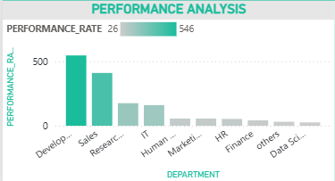
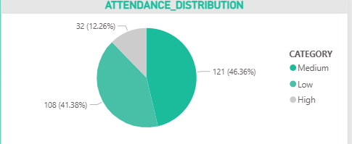
CHARTS
BAR CHART
Compares performance across departments
Uses average performance rate
Helps identify top-performing departments
PIE CHART
Shows distribution of attendance categories
Includes High, Medium, Low attendance
Helps understand attendance trends

Slide 7
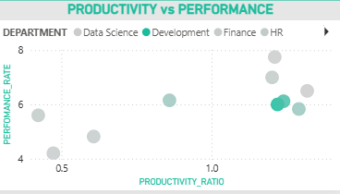
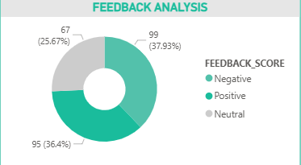
SCATTER PLOT
Shows relationship between productivity and performance
Each point represents an intern
Helps identify performance trends
DONUT CHART
Shows feedback categories
Includes Positive, Neutral, Negative
Reflects performance quality

Slide 8
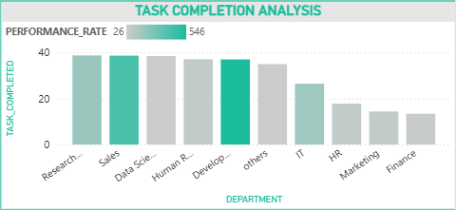
COLUMN CHART
Shows average tasks completed
Compared across departments
Indicates productivity levels

